Slide 1
English - Year 2
Unit 12

Slide 2
Hello children! How are you? Are you ready to learn more things? Let’s become familiar with:
Tropical fruits
and
Animals from other countries

Slide 3
Tropical fruits
Animals from other countries

Slide 4
Tropical fruits
It’s a guava!
I’ ve got a guava!
It’s a mango!
I’ ve got a mango!

Slide 5
Tropical fruits
It’s a pineapple!
I’ ve got a pineapple!
It’s an avocado!
I’ ve got an avocado!

Slide 6
Tropical fruits
passion fruit
tangerine
It’s a passion fruit!
I’ ve got a passion fruit!
It’s a tangerine!
I’ ve got a tangerine!

Slide 7
Animals from other countries
It’s a monkey!
I’ ve got a monkey!
It’s an ostrich!
I’ ve got an ostrich!

Slide 8
Animals from other countries
It’s a zebra!
I’ ve got a zebra!
It’s an elephant!
I’ ve got an elephant!

Slide 9
Animals from other countries
It’s a giraffe!
I’ ve got a giraffe!
It’s an antelope!
I’ ve got an antelope!

Slide 10
Let’s practice!

Slide 11
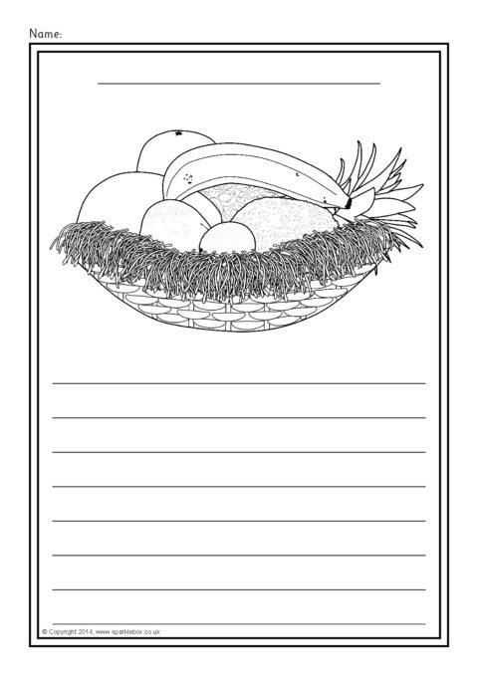
Colour and write:
Colour the fruits in the basket and write them on the lines.
You can start like this:
I like …
I’ ve got…

Slide 12
Draw and colour:
Your favourite tropical fruit!

Slide 13
Draw and colour:
Your favourite animal!

